Slide 1

Performance Tooling in Visual Studio 2015
Knowledge and Tools Every Developer Should Know

Slide 2




About Me
1998 – 2002 Lead Developer / Co-Creator of Day of Defeat – Valve Software LLC
2003 – 2008 SQL Developer - Melior Inc.
2008 – 2015 Senior Developer – ProAssurance
2015 – Present Senior Developer – EBSCO

Slide 3
Memory Systems Overview
What is the difference between Debug and Release modes?
Why is the memory footprint and performance different between the two?
What is this Garbage Collector I keep hearing about in .NET and how does it work?
Notes:
1.) Go over difference in how Debug memory footprints are larger due to the extra data and information they are carrying around with them verses how Release mode is streamlined and performant.
2.) Describe how basic memory systems work in C\C++ real-time applications
3.) Describe how smart pointers work with reference counts such as Boost in C\C++
4.) Describe how general memory management systems work in real time applications and then tie it into the Garbage Collector from a general operation perspective.
Stack = static memory or allocations inside the current method, its fast but is fixed in size so you can go over and get a Stack Overflow exception.
Heap = dynamically allocated memory. Slower but exists after the method it was allocated in and has to be manually free\deleted. Can grow to any size system has available.
http://www.programmerinterview.com/index.php/data-structures/difference-between-stack-and-heap/

Slide 4
What are the common memory mistakes we make?
Not properly closing our connections.
Holding references to managed objects.
Failing to release unmanaged resources.
Notes:
Failing to release unmanaged resources When you interoperate with native APIs (ex: via P/Invoke), your application needs to follow the native code memory management semantics — loaded objects must be unloaded, allocated memory must be freed, etc. A good example is forgetting to call ReleaseDC when getting a reference using GetDC.
https://blogs.msdn.microsoft.com/davidklinems/2005/11/16/three-common-causes-of-memory-leaks-in-managed-applications/

Slide 5
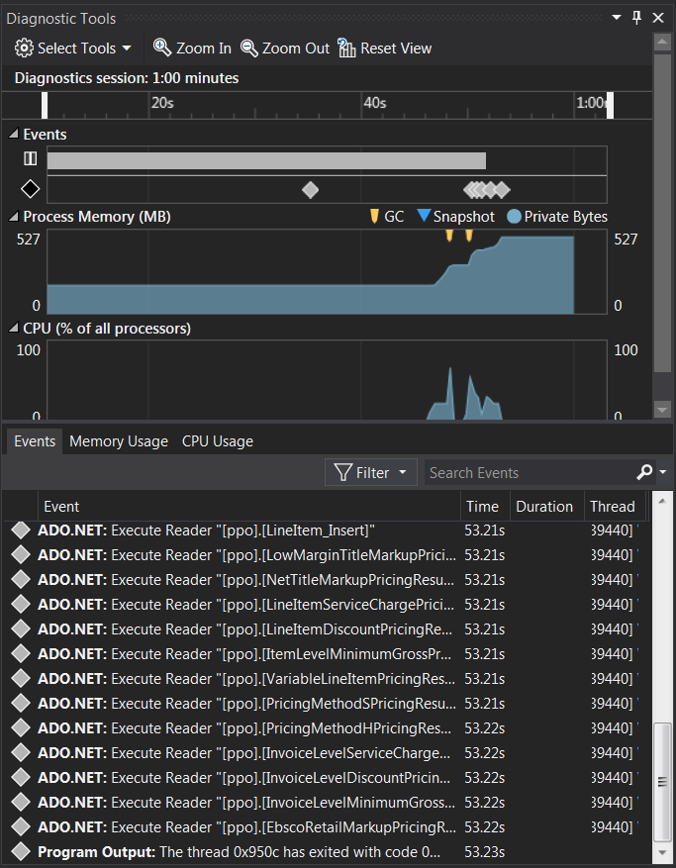
What are the Performance and Diagnostic Tools in Visual Studio 2015?
Notes:
Whenever you enter into Debug mode you should see this panel popup by default on the right-hand side of the screen. If you was like me, it’s probably one of those things you quickly unpinned or closed to move out of your way, totally ignoring what it actually did or could do for you.

Slide 6
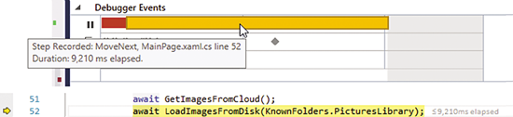
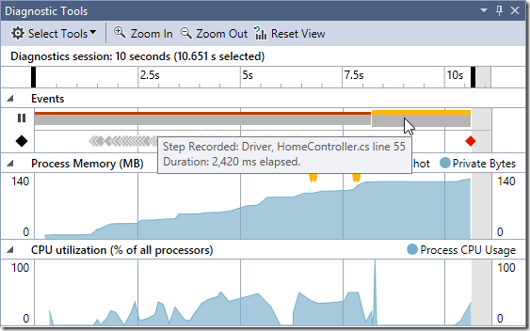
What are the Performance and Diagnostic Tools in Visual Studio 2015?
Break Events with PerfTips
CPU and Memory Analysis
Notes:
Break Events History and PerfTips The Break Events let you see how long each section of code took to run. Adds an elapsed time tag out beside the breakpoint.
CPU and Memory Analysis The time range selection lets you correlate ranges on the CPU Usage and Memory Usage graphs so that you can understand the CPU and memory characteristics of specific sections of code. The graphs continue to update while the app is running, which lets you keep an eye on CPU and memory as you interact with your app. You can switch to the Memory Usage tab to take snapshots and view a detailed breakdown of memory usage.

Slide 7
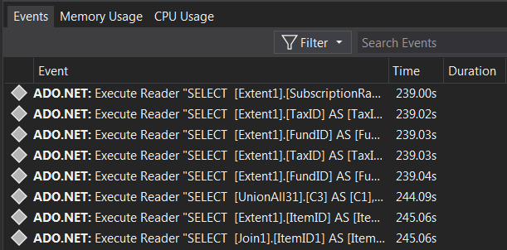
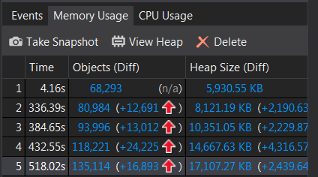
What are the Performance and Diagnostic Tools in Visual Studio 2015?
IntelliTrace Performance Insights
Memory & CPU Usage
Notes:
IntelliTrace Performance Insights IntelliTrace adds two tracks to the Debugger Events timeline: the Output track and the IntelliTrace track. These events include information shown in the Output window, plus additional events collected by IntelliTrace, such as Exceptions, ADO.NET and so on. The events in these tracks are also shown in the Debugger Events Table.
You can relate IntelliTrace events to CPU Usage spikes and Memory Usage graphs. The time stamps show you how long various actions in your app take. For example, you can add Debug.WriteLine statements in your code and use the timestamps on the Output events to see how long it takes to run from one statement to the next.
Memory & CPU Usage The Memory Usage graph shows a high-level view of how your application is using memory. There’s a performance counter named Private Bytes for your app. Private Bytes is a measure of the total amount of memory allocated to a process. That doesn’t include memory shared with other processes. It includes the managed heap, native heap, thread stacks and other memory (such as private sections of loaded .dll files).

Slide 8
DEMO TIME

Slide 9
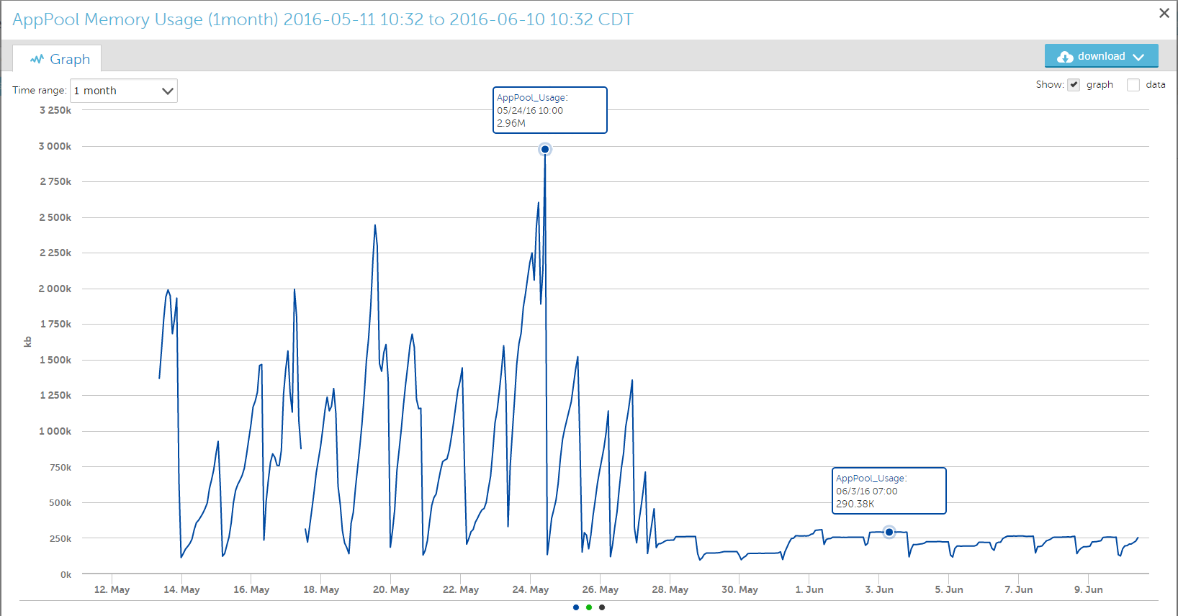
Case Study 1 – Memory Usage Before & After
Notes:
Feature Flags

Slide 10
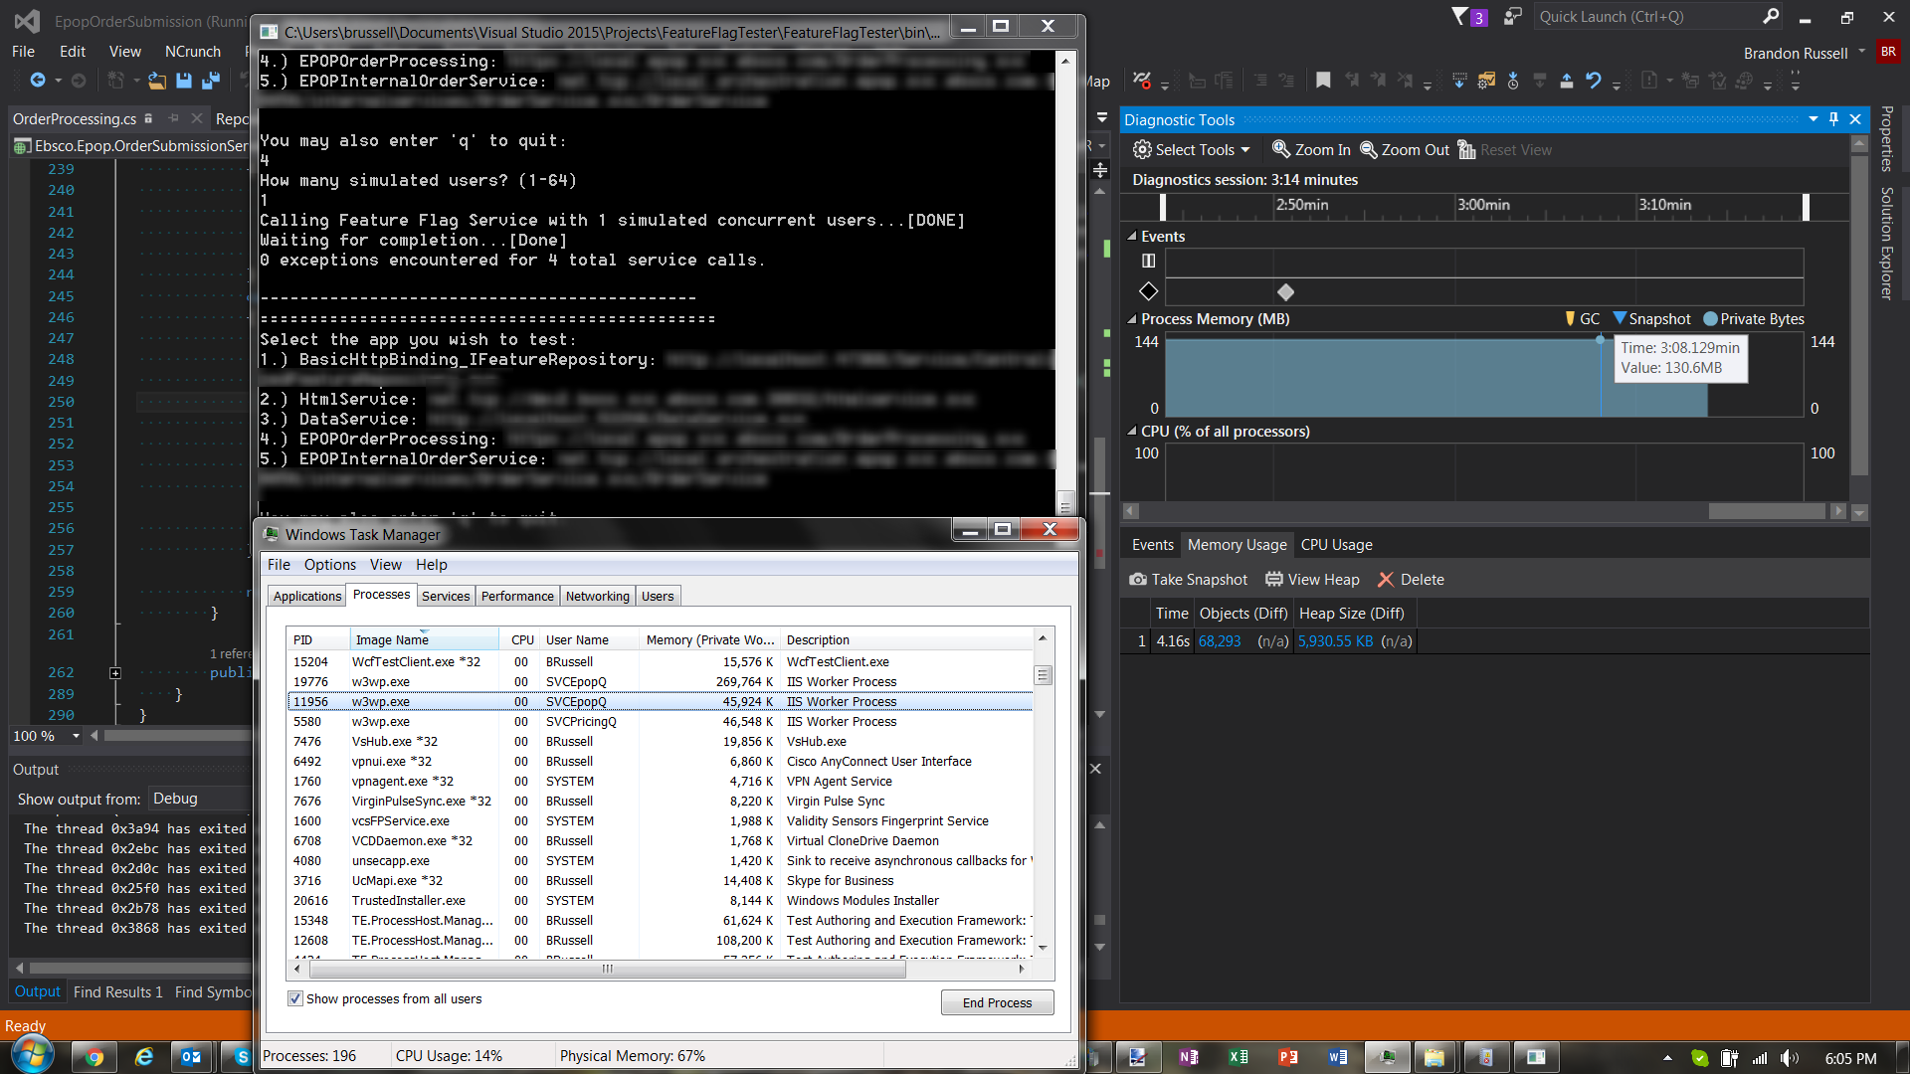
Case Study 2 – Probing For Issues

Slide 11

Case Study 2 – Probing For Issues
Notes:
Here I have pounded the service with 20 simulated concurrent users and waited until it was complete, then I took a snapshot.

Slide 12
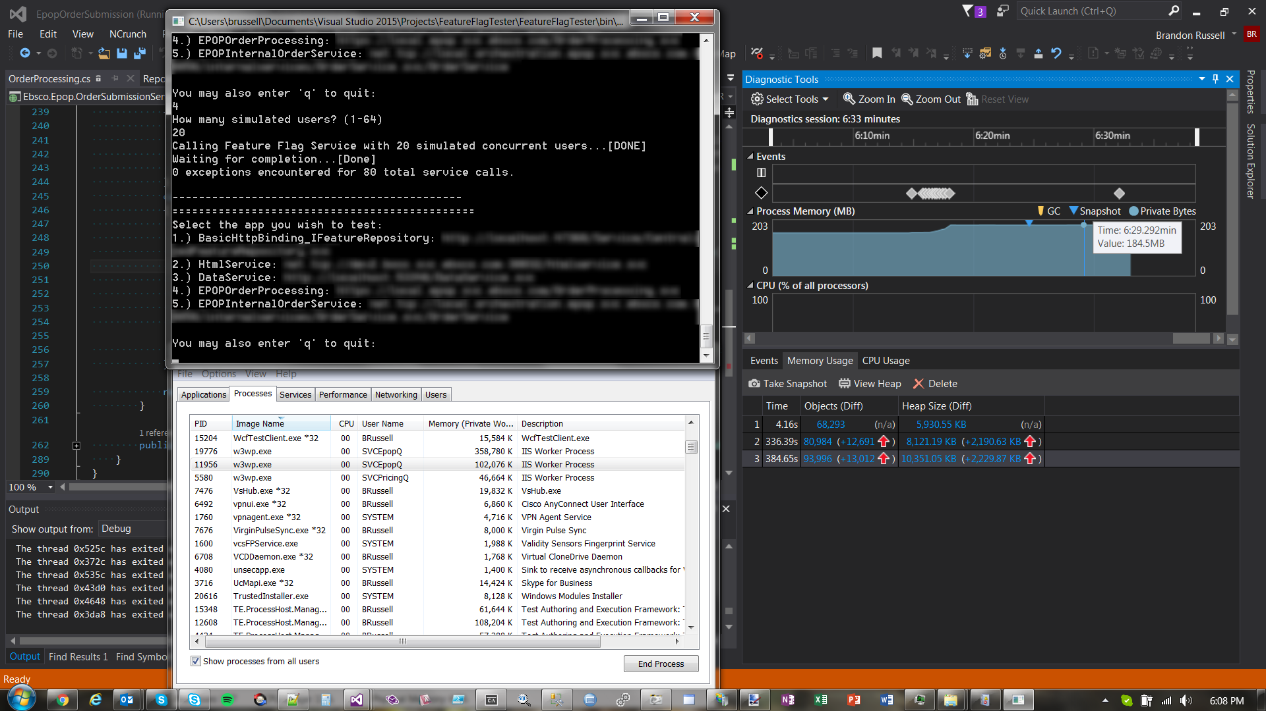
Case Study 2 – Probing For Issues
Notes:
Here I continue to pound the service with 20 simulated concurrent users and waited until it was complete, then I took another snapshot. Notice the memory is not going down and my object count is not going down either.

Slide 13
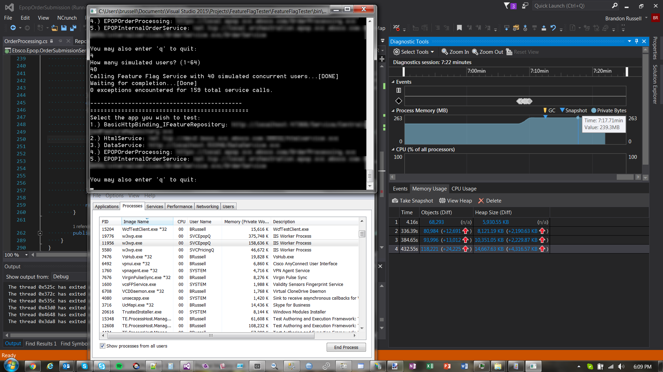
Case Study 2 – Probing For Issues
Notes:
This time I hit the service with 40 simulated concurrent users and waited until it completed and took another snapshot. Now it’s becoming evident memory is not releasing and object reference count is only continuing to rise. Notice the memory in task manager as well.

Slide 14
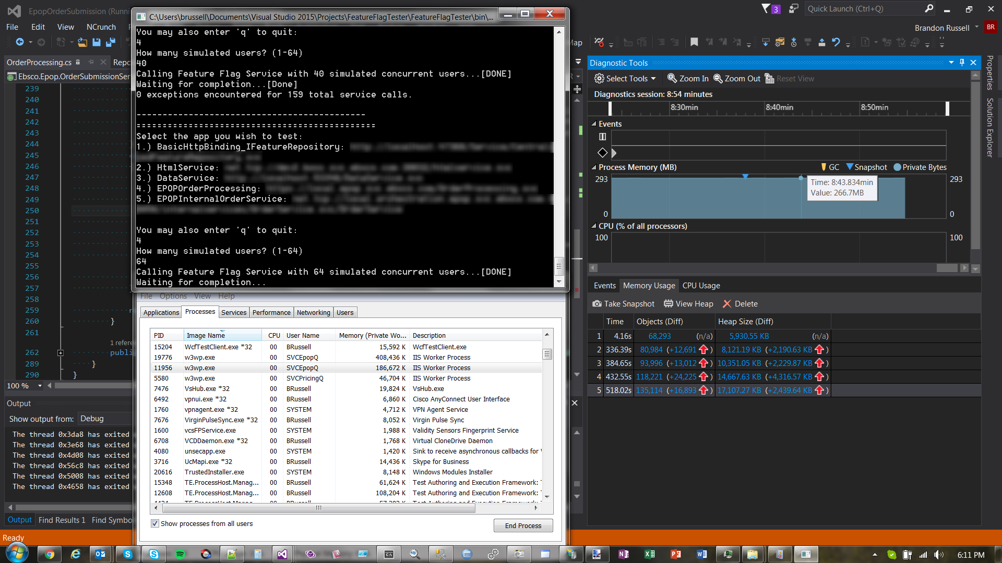
Case Study 2 – Probing For Issues
Notes:
Finally, I decided to go for the gold, I hit the service with 64 simulated concurrent users and this time the service stopped responding. Notice the memory has never released and our object count has continued to rise as well as memory in task manager.

Slide 15
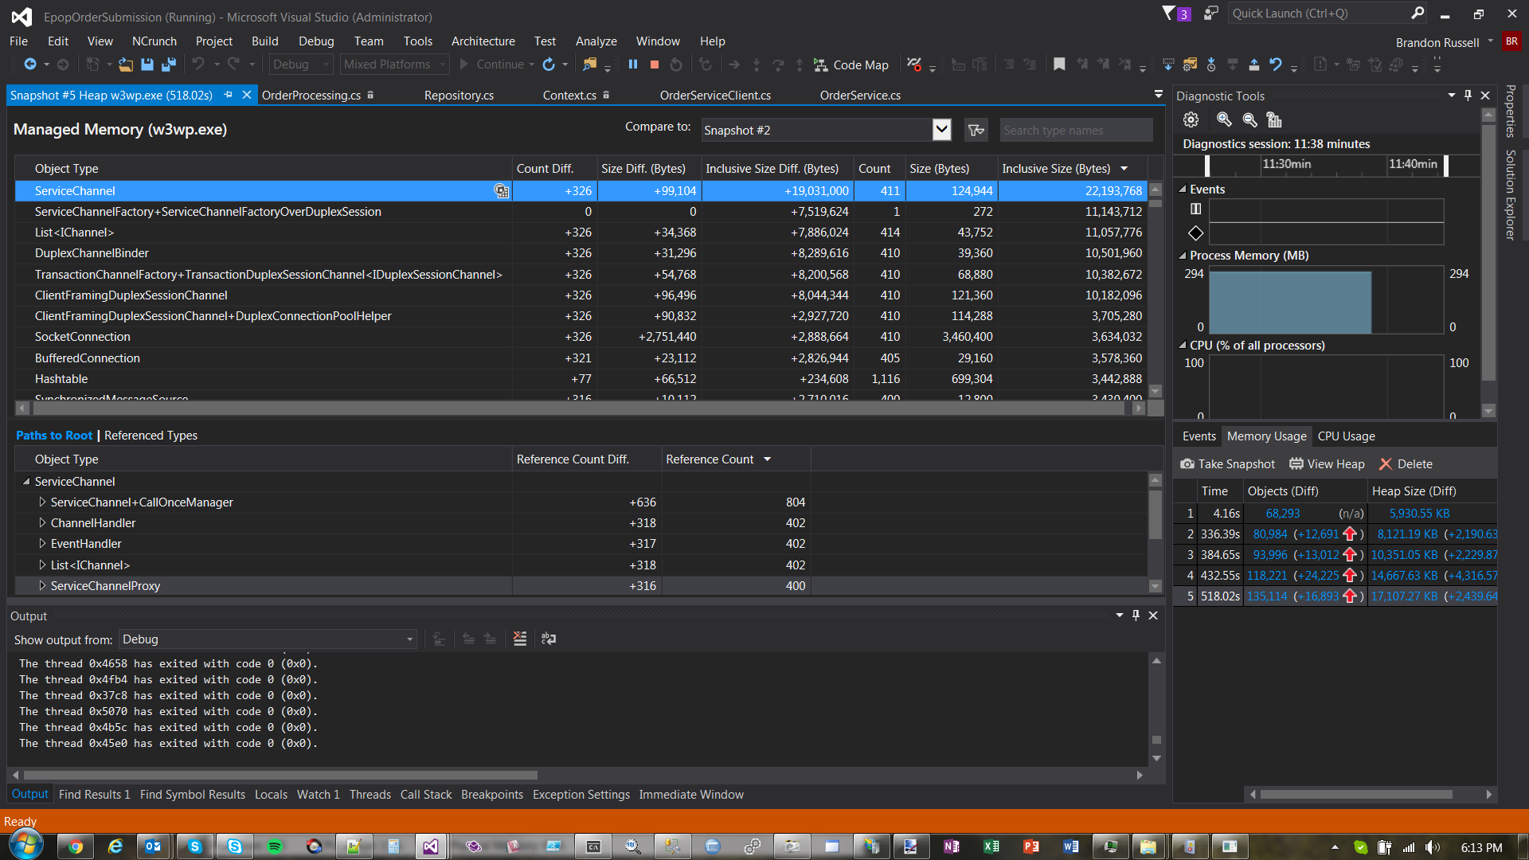
Case Study 2 – Probing For Issues
Notes:
So now I am looking over the results and comparing snapshots to one another to see what rises to the top as a possible issue. You will notice ServiceChannel and ServiceChannelFactory are top of the list, possible clue here.

Slide 16
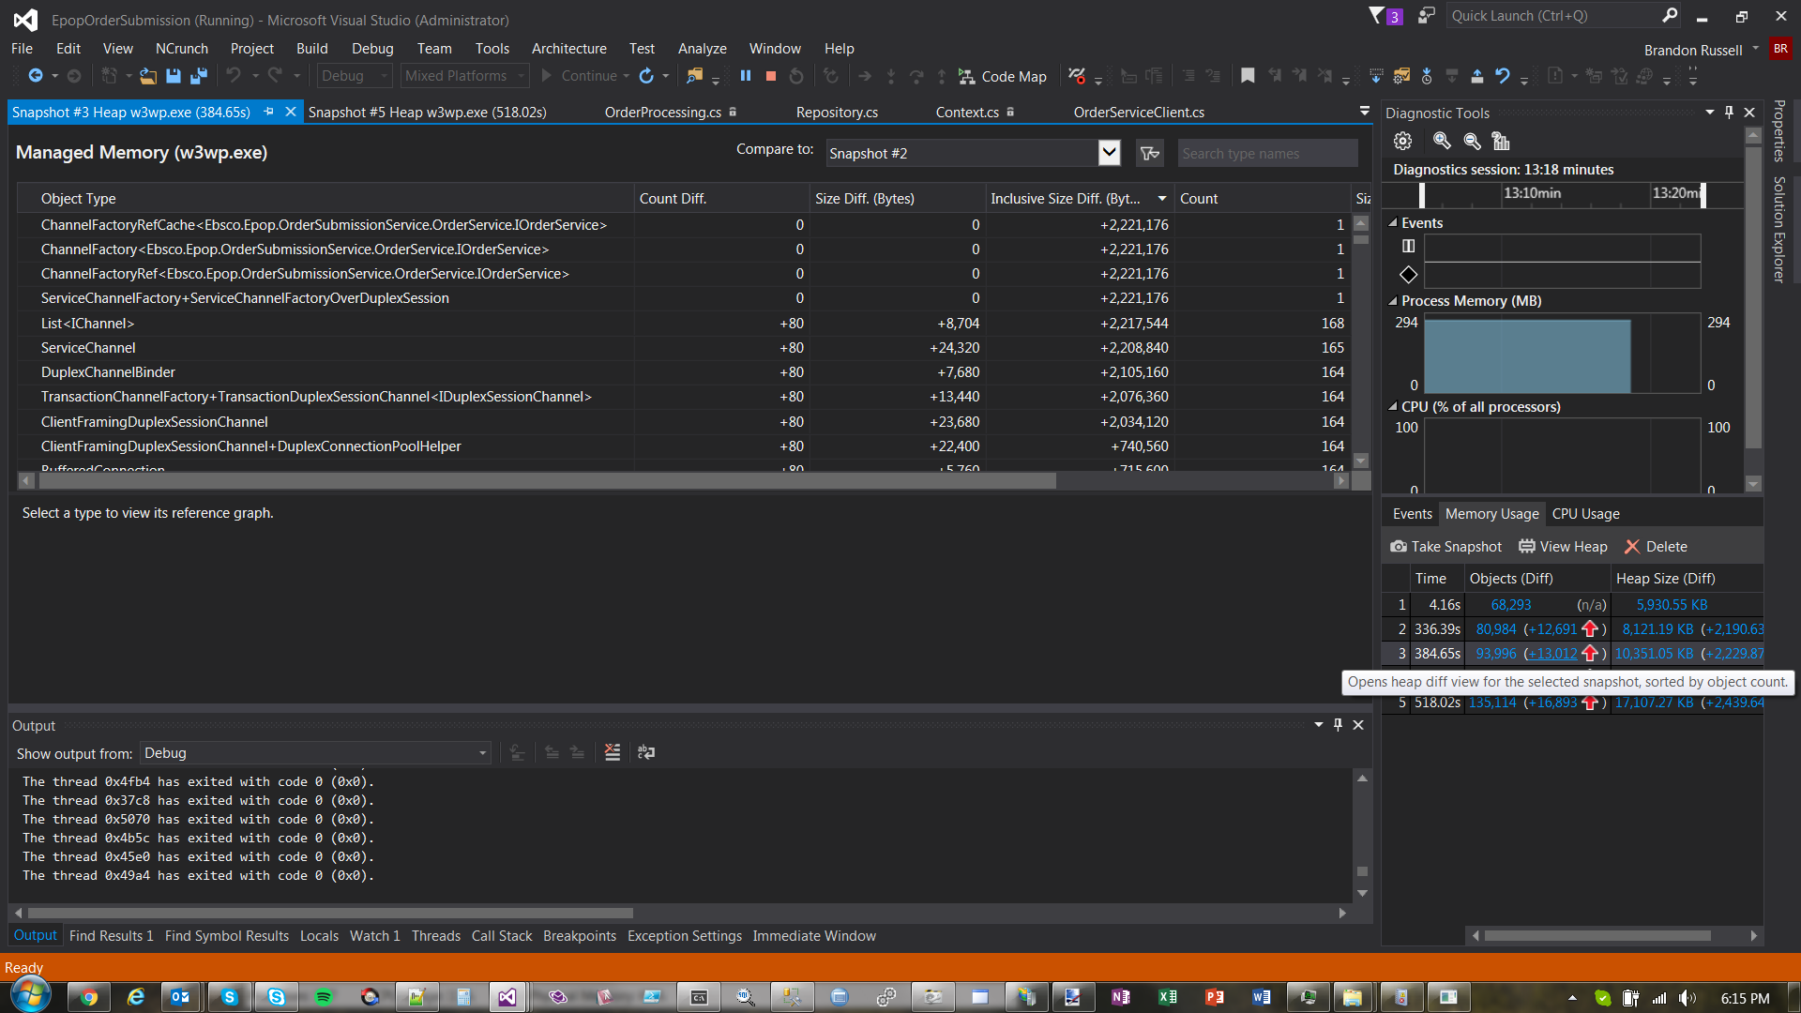
Case Study 2 – Probing For Issues
Notes:
Finally, I get a view that shows me what service clients are actually the culprits. I believe the evidence is in, let the fixes begin.

Slide 17
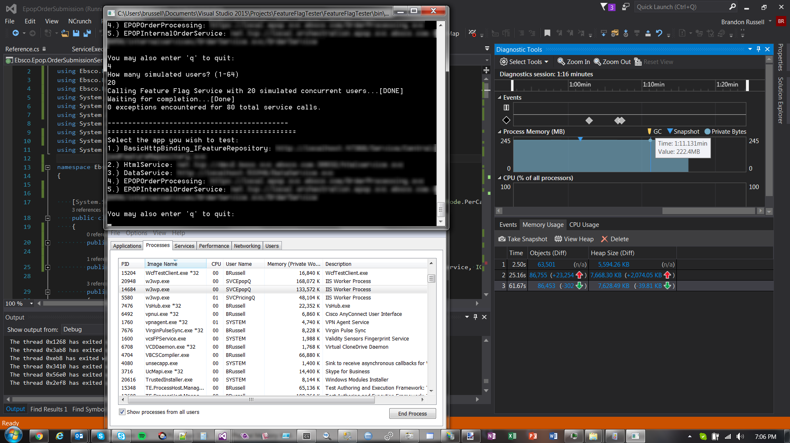
Case Study 2 – After The Fixes
Notes:
After identifying the issues and applying a fix we can immediately see a big difference already after running a couple of 20+ concurrent users through the system. Notice the green arrow on the right in memory usage box indicating that we are finally releasing resources as we would expect between loads.

Slide 18
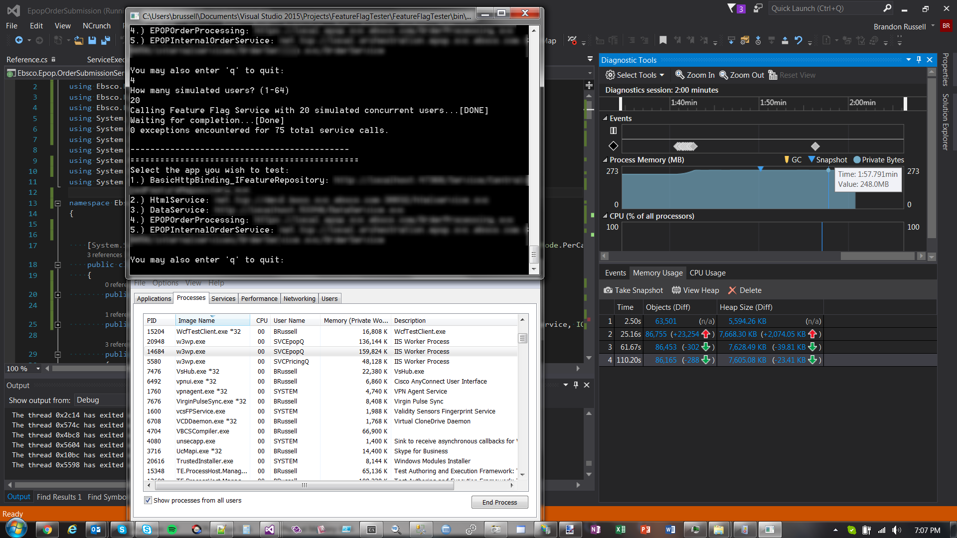
Case Study 2 – After The Fixes
Notes:
Here again we are showing good releasing of memory and objects behind the scenes between load tests. Notice the memory usage in task manager staying low for both processes as well now.

Slide 19
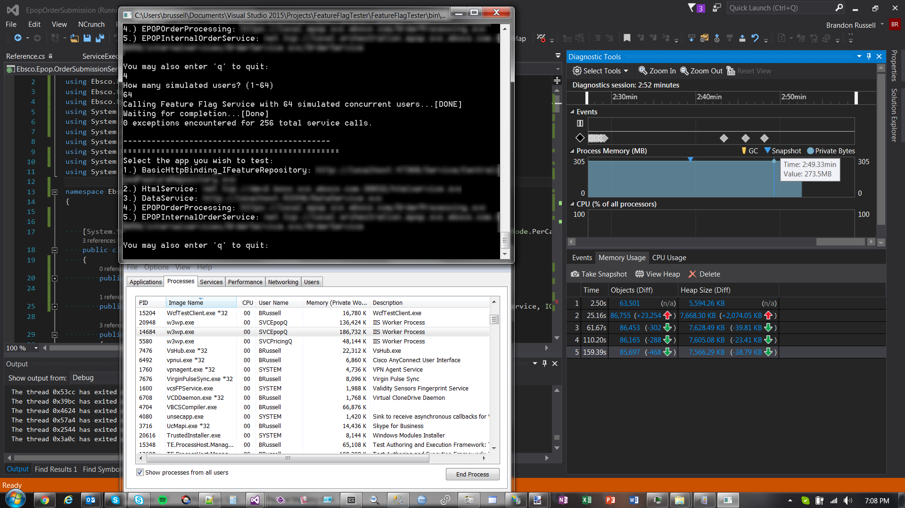
Case Study 2 – After The Fixes
Notes:
Here I finally begin pounding the service with 64 simulated concurrent users and notice the difference from previous screen shots. We are actually continuing to release memory every snapshot, and objects are properly freeing up behind the scenes. What you don’t see is I continue to hit the service for 30 minutes with 64 concurrent users, taking snapshots all along the way and it never once showed signs again of holding onto memory. It continued to release memory every snapshot, and memory usage for both processes in task manager stayed low and freed along the way.

Slide 20


Slide 21


Slide 22
Performance Tooling in Visual Studio 2015
Knowledge and Tools Every Developer Should Know
Email: blrussell@gmail.com Twitter: @brussellz GitHub: www.github.com/brussellz/WCFMemoryLeak

